Slide 1
LOW LATENCY SCHEDULING FOR DELAY SENSITIVE APPLICATIONS
Team Members:
Aravinth S - 2018105010
Gnanavel K M - 2018105528
Gowtham P - 2018105531
Yokesh N - 2018105623
Project Guide : Dr.M.A.Bhagyaveni

Slide 2
OBJECTIVE
Large amount of data generated by IoT devices is sent to the cloud for processing.
There is a huge delay due to this, our idea is to reduce the delay between the IoT devices and cloud services.
So it is very useful in IoT Applications such as healthcare applications, wearables, intelligent transportation systems and smart cities.
Certain delay sensitive applications require low latency , to address this issue we introduce a number of scheduling algorithms.
We compare the benefits of different scheduling algorithms using iFogsim simulator.

Slide 3
INTRODUCTION
In today's world, the internet of things (IoT) is developing rapidly.
Wireless sensor network (WSN) as an infrastructure of IoT has limitations in the processing power, storage, and delay for data transfer to cloud.
Also sending all the data generated by the IoT to the cloud may not be possible due to limited data carrying capacity of the current network infrastructure.
Fog Computing (FC) has been introduced to bring the cloud services closer to the data generating loT devices.
FC as an extension of cloud to the edge of the network reduces latency and traffic thus, it is very useful in loT applications.

Slide 4
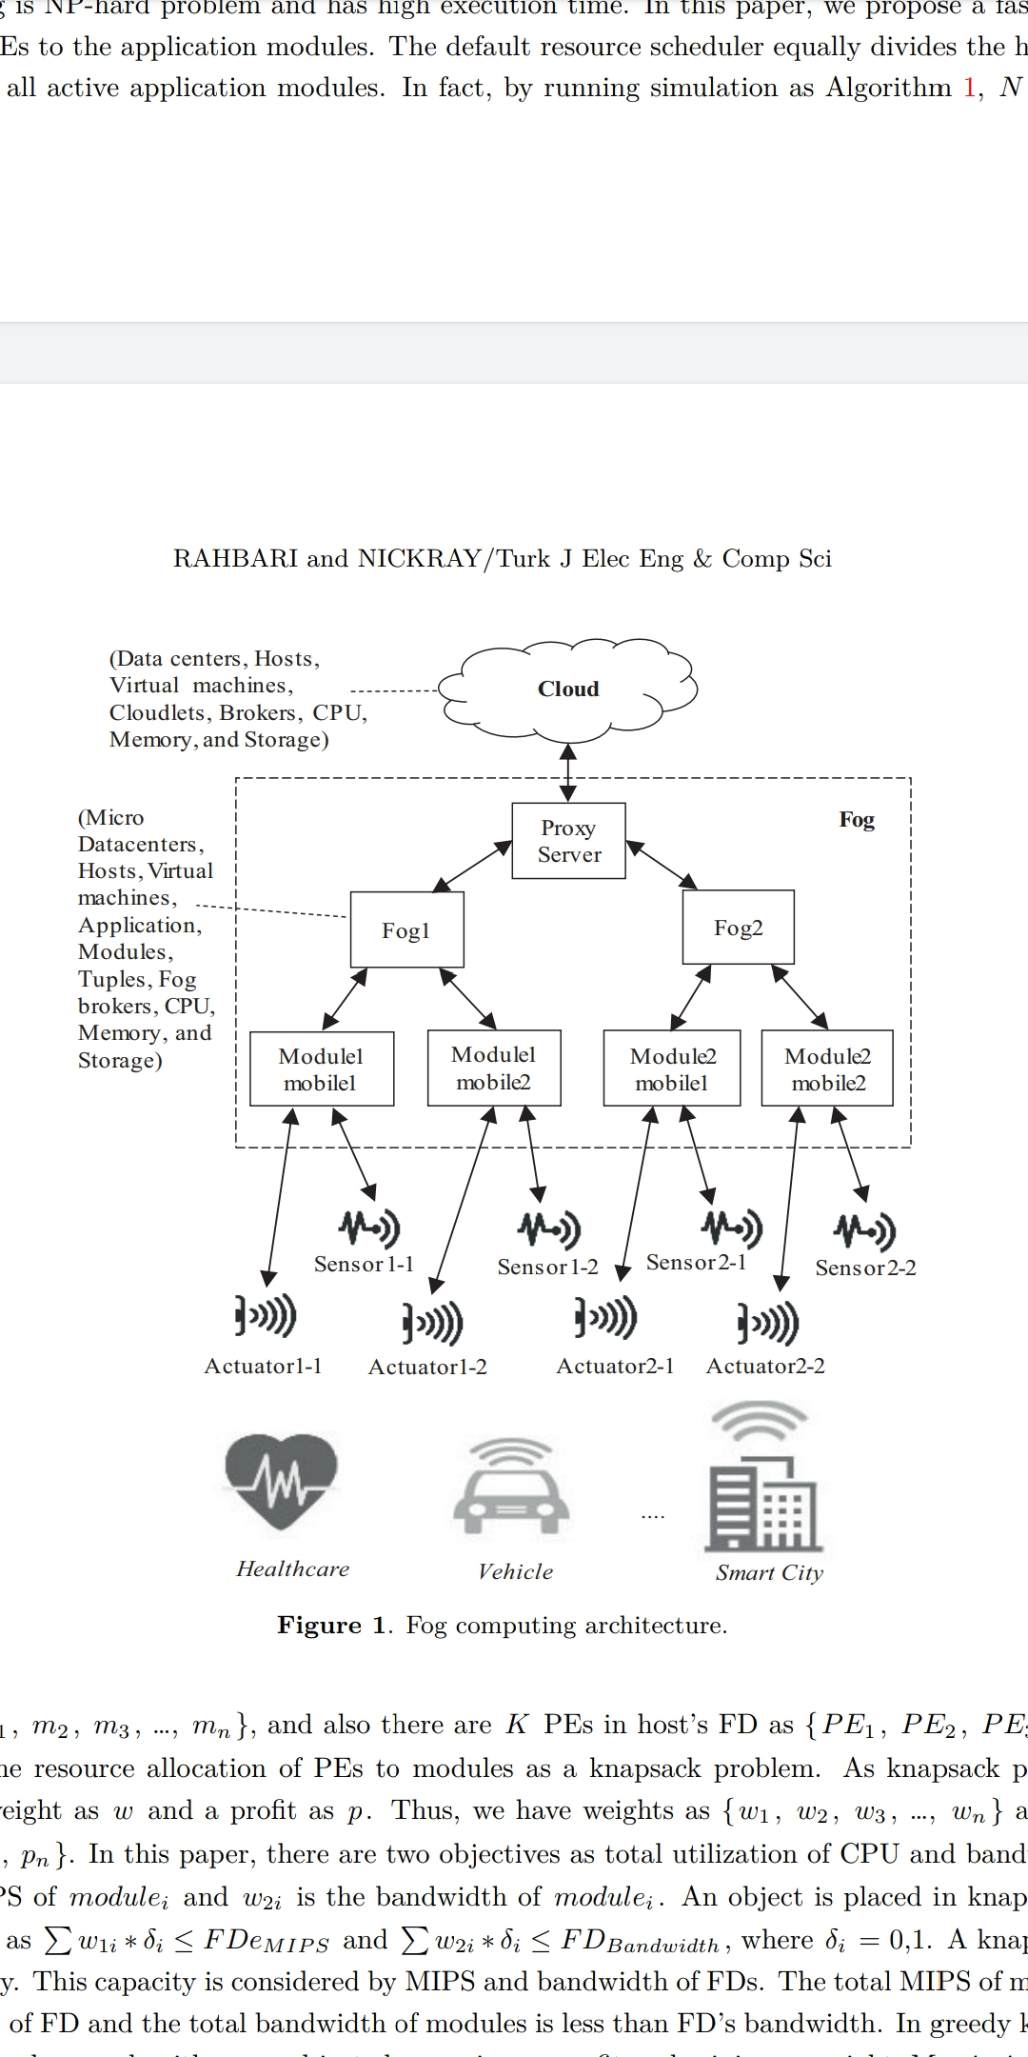
ARCHITECTURE OF FOG COMPUTING

Slide 5
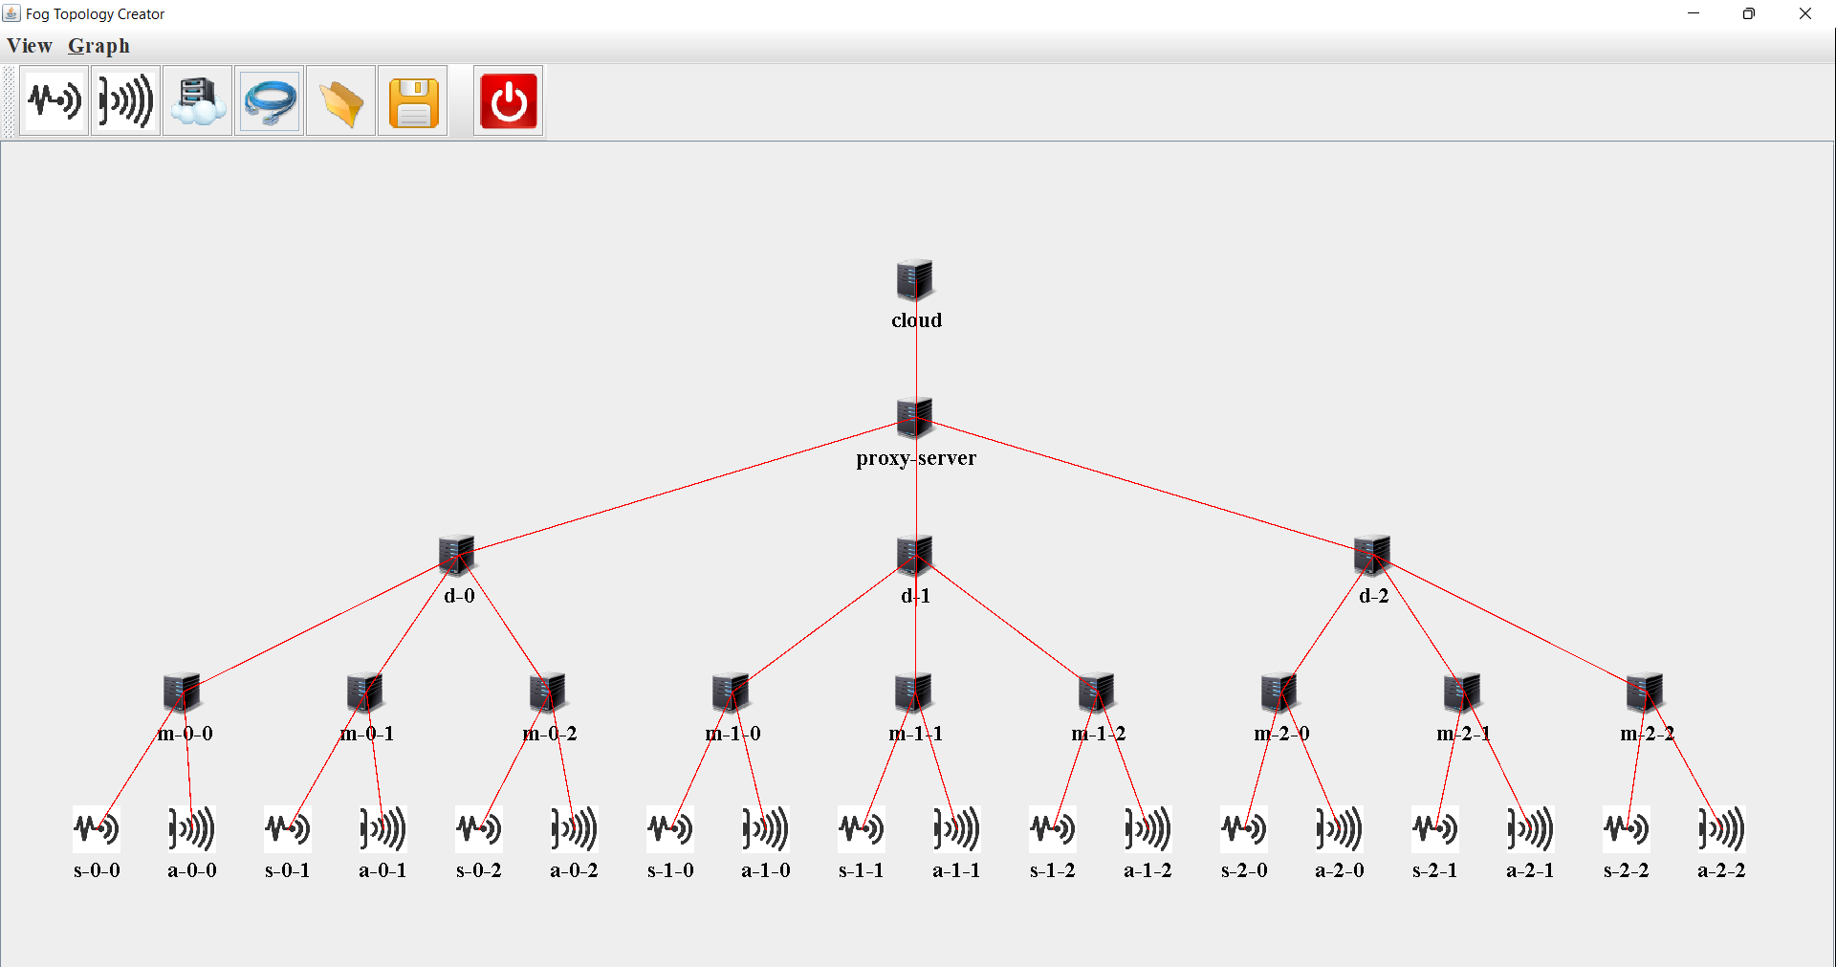
ARCHITECTURE DESIGNED USING GUI

Slide 6
IMPLEMENTATION
Architecture of the total network is designed.
Number of fog devices, sensors, actuators are inserted as per our requirement.
Application is created based on the type of IoT service required, and divided into several modules.
The modules are mapped to the fog devices.
First come First serve algorithm is implemented.
Priority scheduling , Priority based on Threshold value, Knapsack Algorithms are implemented.
The results of all the above mentioned algorithms (FCFS, Priority, Knapsack) will be compared with each other.

Slide 7
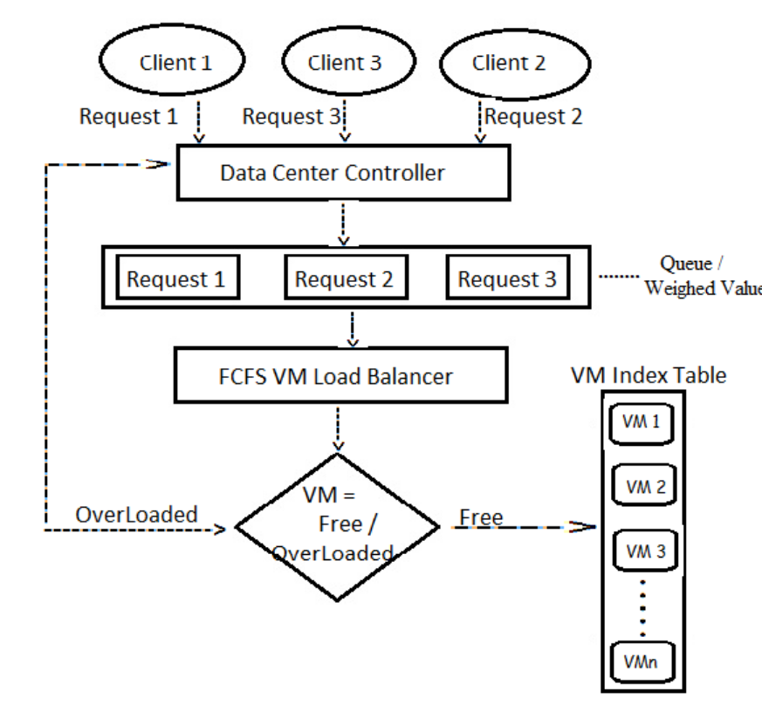
FCFS ALGORITHM

Slide 8
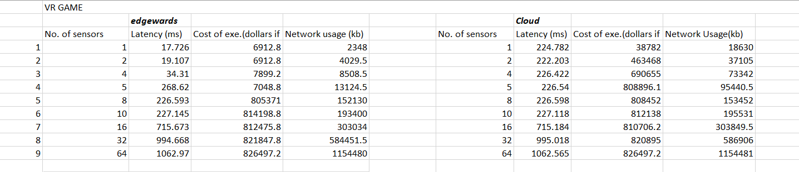
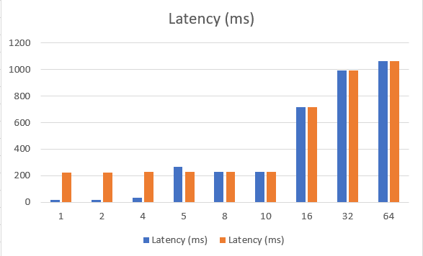
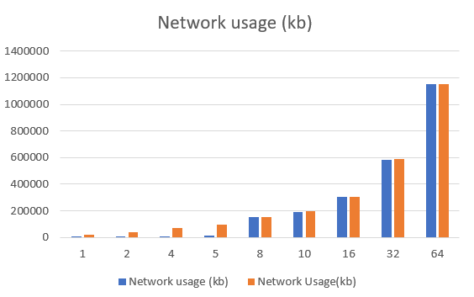
RESULTS

Slide 9
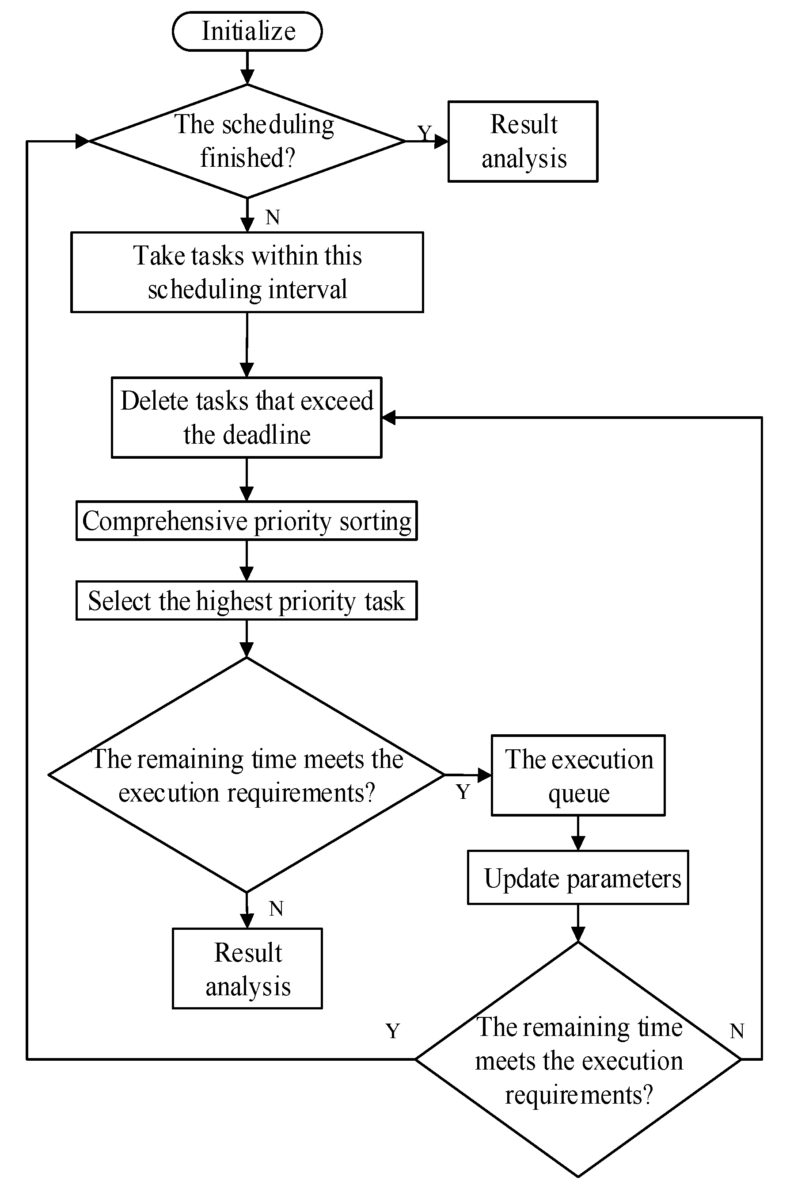
PRIORITY SCHEDULING ALGORITHM

Slide 10
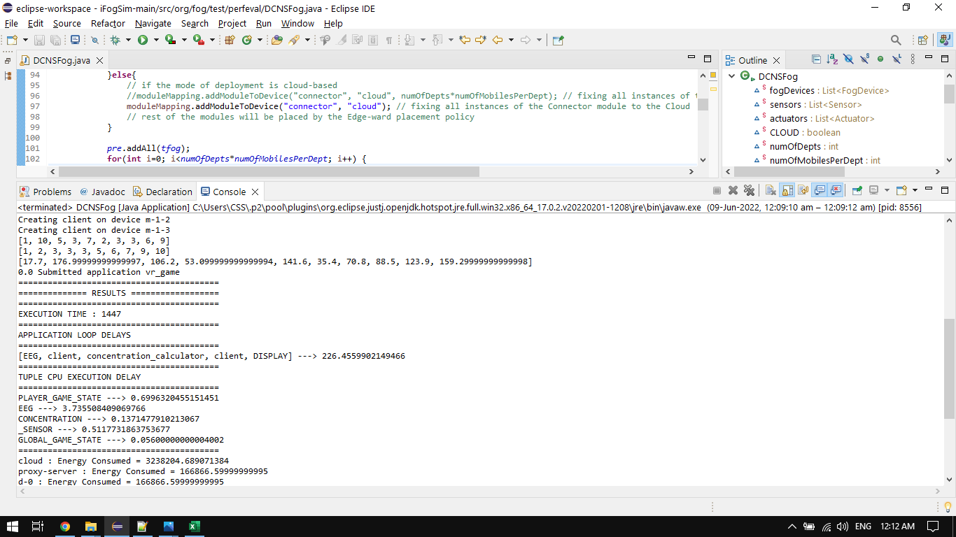
RESULTS

Slide 11
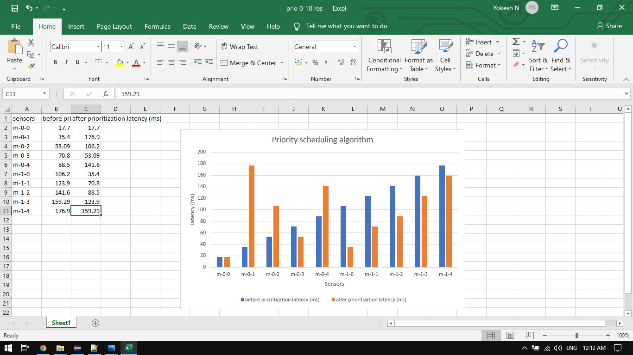
RESULTS

Slide 12
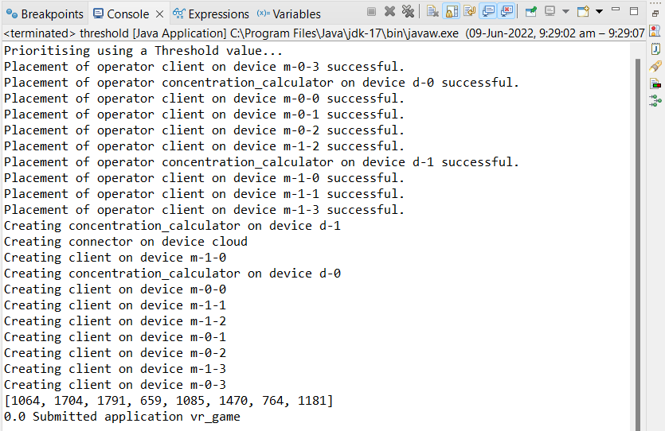
PRIORITY BASED ON THRESHOLD

Slide 13
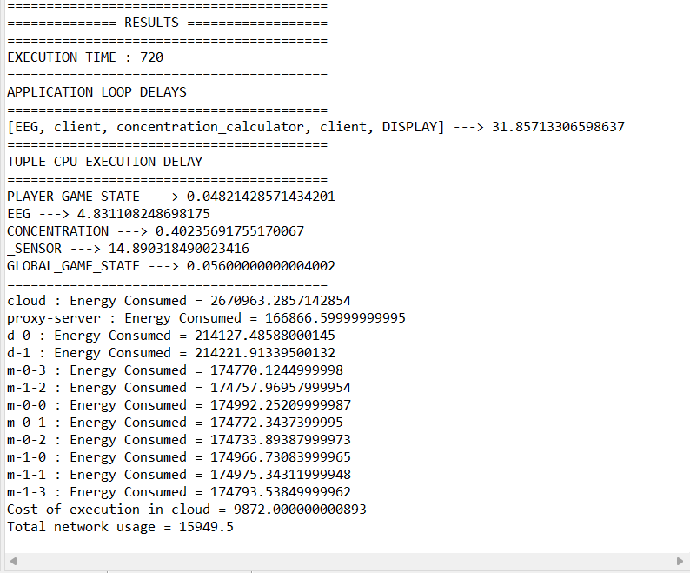
PRIORITY BASED ON THRESHOLD

Slide 14
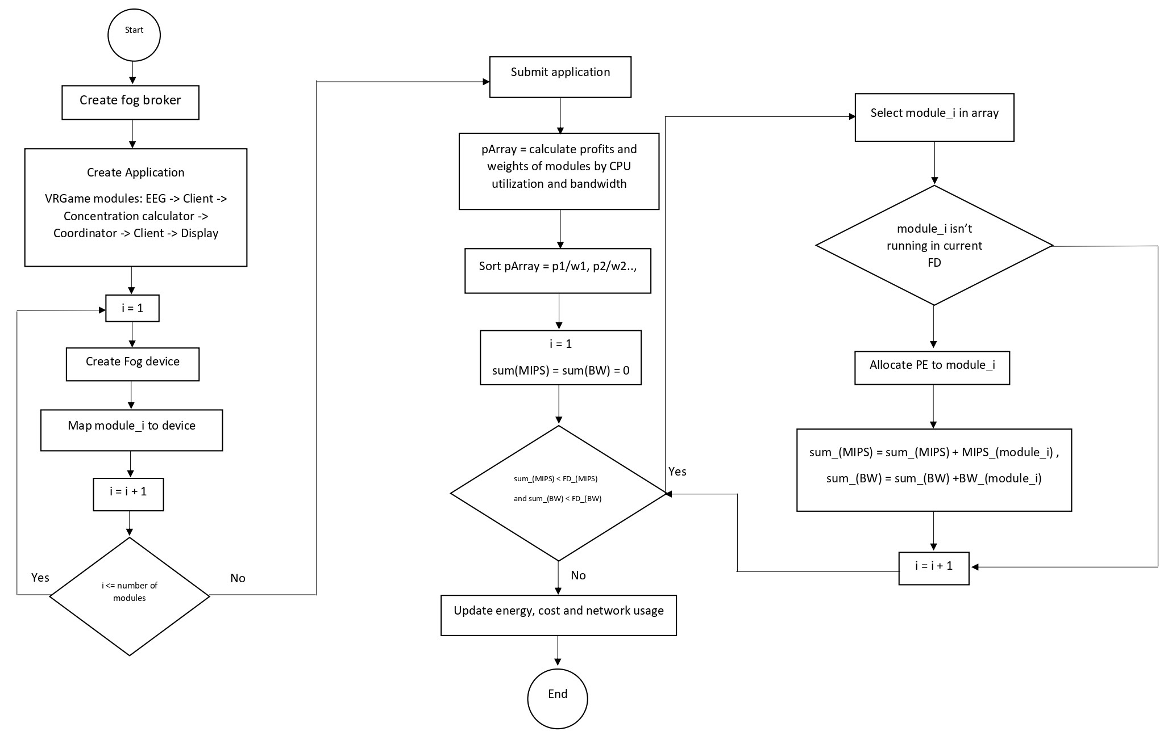
KNAPSACK ALGORITHM

Slide 15
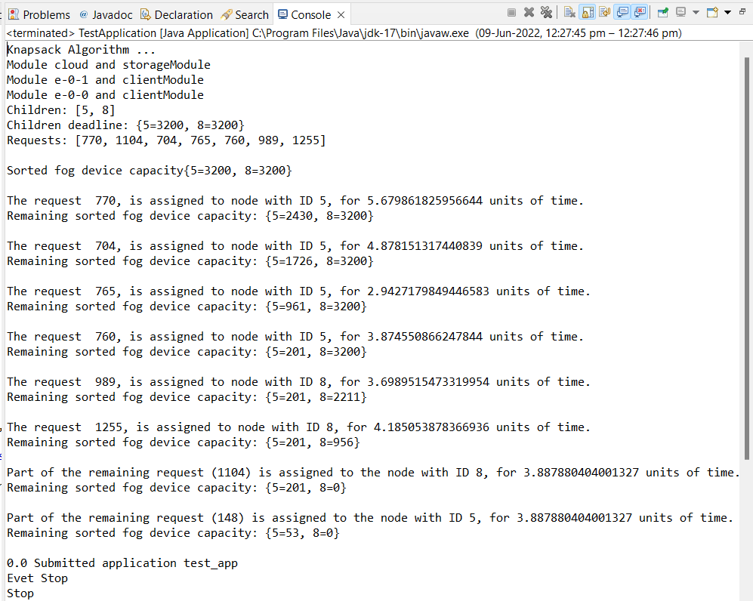
RESULTS

Slide 16
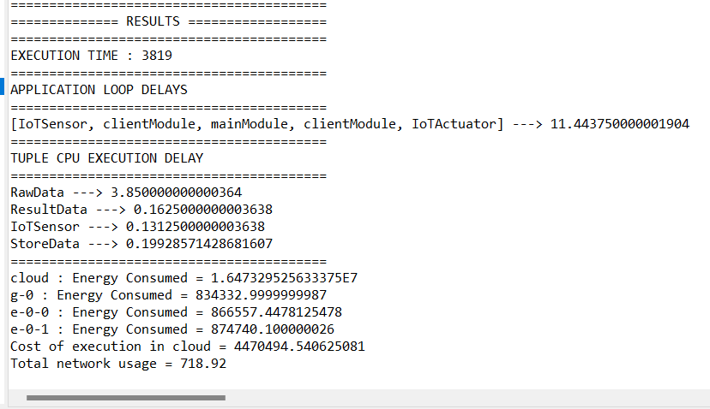
RESULTS

Slide 17
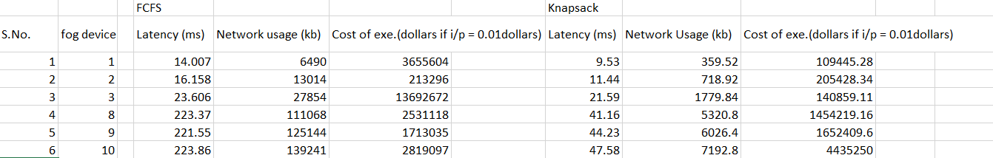
COMPARISON

Slide 18
COMPARISON

Slide 19
CONCLUSION
Many IoT devices process lot of data and requests need to be handled with as less delay as possible. Fog layer takes care of this as it is placed between client and the cloud layer.
Fog computing provides lower communication latency and computing capacity closer to the final user.
From the results, it was found out that some algorithms perform better for execution time and some perform better cost-wise.
Depending on the requirements of the system, one can choose priority scheduling for quicker execution or one can choose Knapsack algorithm for low latency.
Thus usingknapsack algorithm, we have reduced latency by 3.6 times and network usage by 92% when compared with FCFS algorithm.

Slide 20
REFERENCE
L. F. Bittencourt, J. Diaz-Montes, R. Buyya, O. F. Rana and M. Parashar, "Mobility-Aware Application Scheduling in Fog Computing," in IEEE Cloud Computing, vol. 4, no. 2, pp. 26-35, March-April 2017, doi: 10.1109/MCC.2017.27.
J. X. Liao and X. W. Wu, "Resource Allocation and Task Scheduling Scheme in Priority-Based Hierarchical Edge Computing System," 2020 19th International Symposium on Distributed Computing and Applications for Business Engineering and Science (DCABES), 2020, pp. 46-49, doi: 10.1109/DCABES50732.2020.00021.
Gupta H, Dastjerdi AV, Ghosh SK, Buyya R. ifogsim: toolkit for modeling and simulation of resource management techniques in internet of things, edge and fog computing environments. Software: Practice and Experience 2017; 47(9): 1275-1296. doi: 10.1002/spe.2509

